Slide 1
Matrix Algebra
Dr. Pradeep .J.Jha

Slide 2
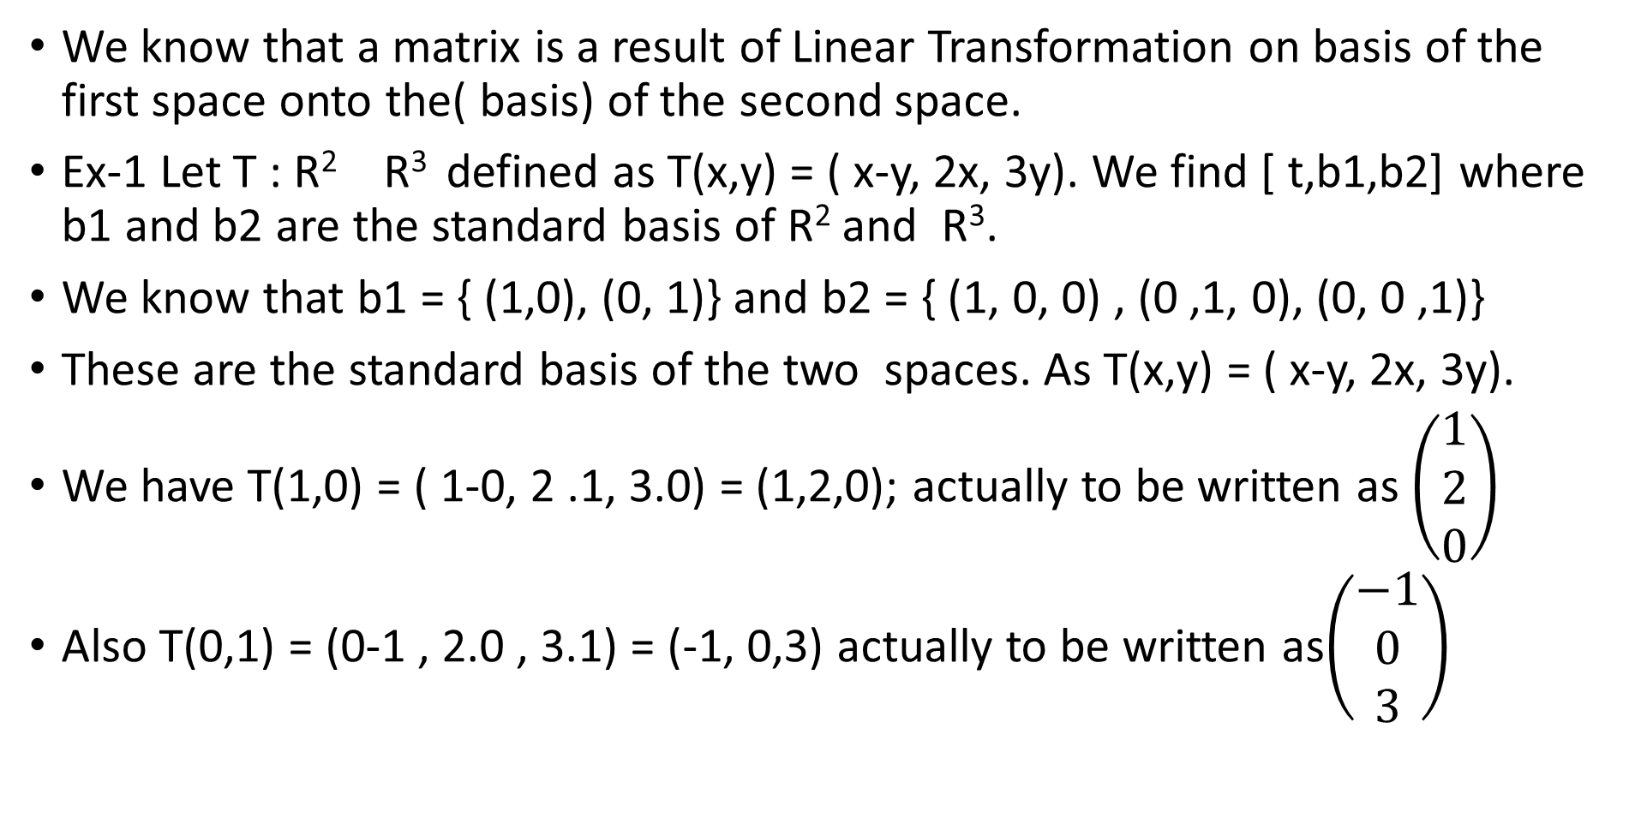
LALP. 3.1
We know that a matrix is a result of Linear Transformation on basis of the first space onto the( basis) of the second space.
Ex-1 Let T : R² R³ defined as T(x,y) = ( x-y, 2x, 3y). We find [ t,b1,b2] where b1 and b2 are the standard basis of R² and R³.
We know that b1 = { (1,0), (0, 1)} and b2 = { (1, 0, 0) , (0 ,1, 0), (0, 0 ,1)}
These are the standard basis of the two spaces. As T(x,y) = ( x-y, 2x, 3y).
We have T(1,0) = ( 1-0, 2 .1, 3.0) = (1,2,0); actually to be written as $\left(\begin{matrix}1 \\ 2 \\ 0\end{matrix}\right)$
Also T(0,1) = (0-1 , 2.0 , 3.1) = (-1, 0,3) actually to be written as$\left(\begin{matrix}−1 \\ 0 \\ 3\end{matrix}\right)$

Slide 3
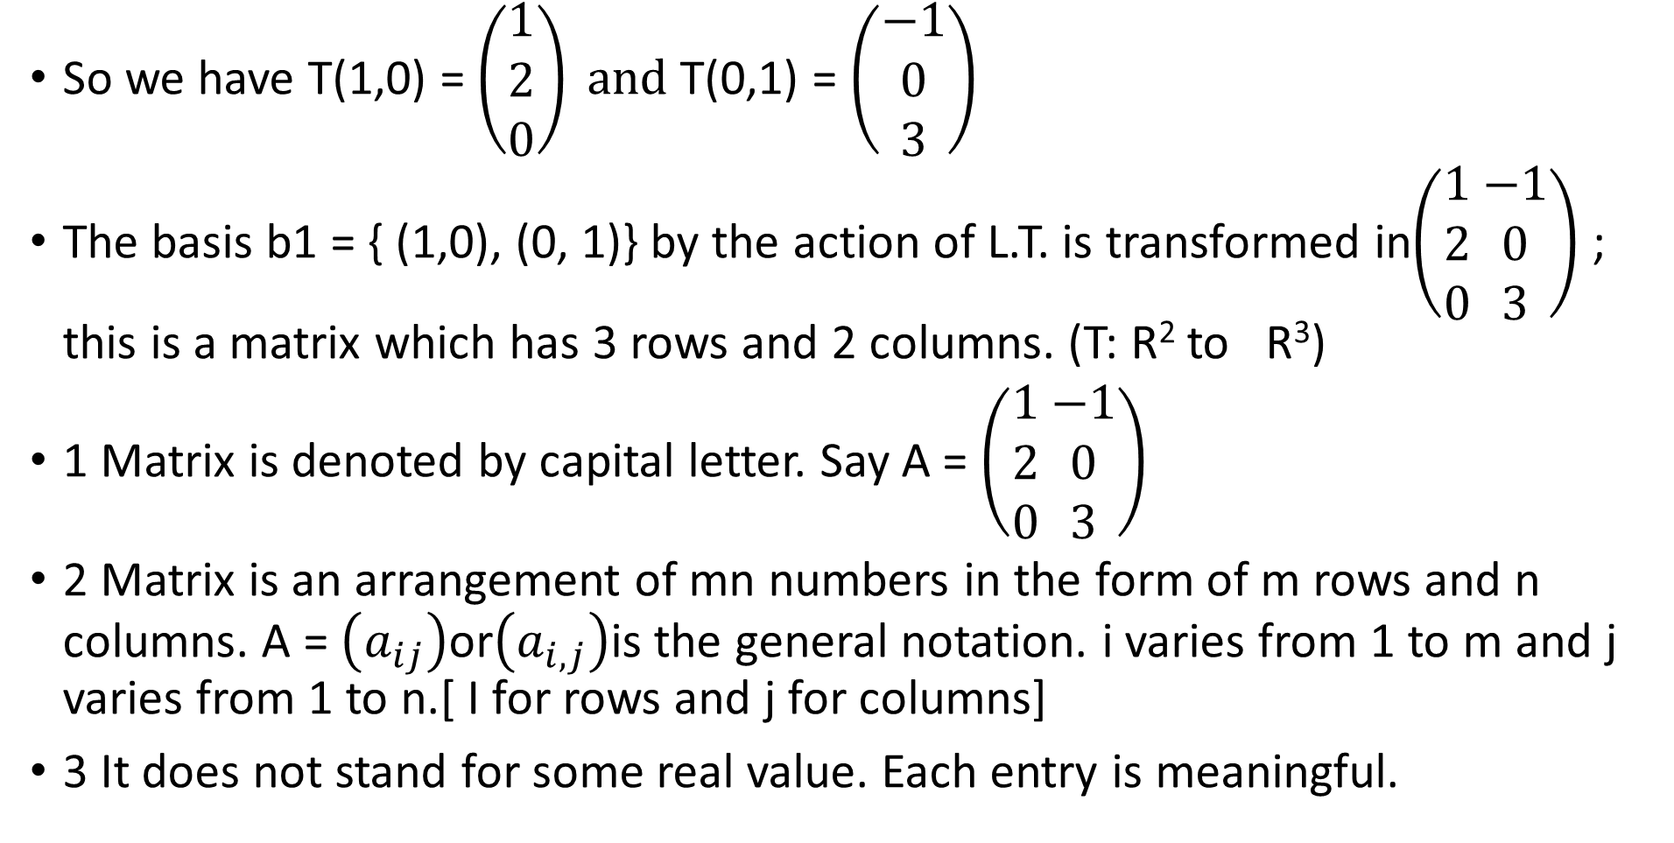
LALP. 3.2
So we have T(1,0) = $\left(\begin{matrix}1 \\ 2 \\ 0\end{matrix}\right) and$T(0,1) = $\left(\begin{matrix}−1 \\ 0 \\ 3\end{matrix}\right)$
The basis b1 = { (1,0), (0, 1)} by the action of L.T. is transformed in$\left(\begin{matrix}1 \\ 2 \\ 0\end{matrix} \begin{matrix}−1 \\ 0 \\ 3\end{matrix}\right)$ ; this is a matrix which has 3 rows and 2 columns. (T: R² to R³)
1 Matrix is denoted by capital letter. Say A = $\left(\begin{matrix}1 \\ 2 \\ 0\end{matrix} \begin{matrix}−1 \\ 0 \\ 3\end{matrix}\right)$
2 Matrix is an arrangement of mn numbers in the form of m rows and n columns. A = $\left(a_{ij}\right)$or$\left(a_{i,j}\right)$is the general notation. i varies from 1 to m and j varies from 1 to n.[ I for rows and j for columns]
3 It does not stand for some real value. Each entry is meaningful.

Slide 4
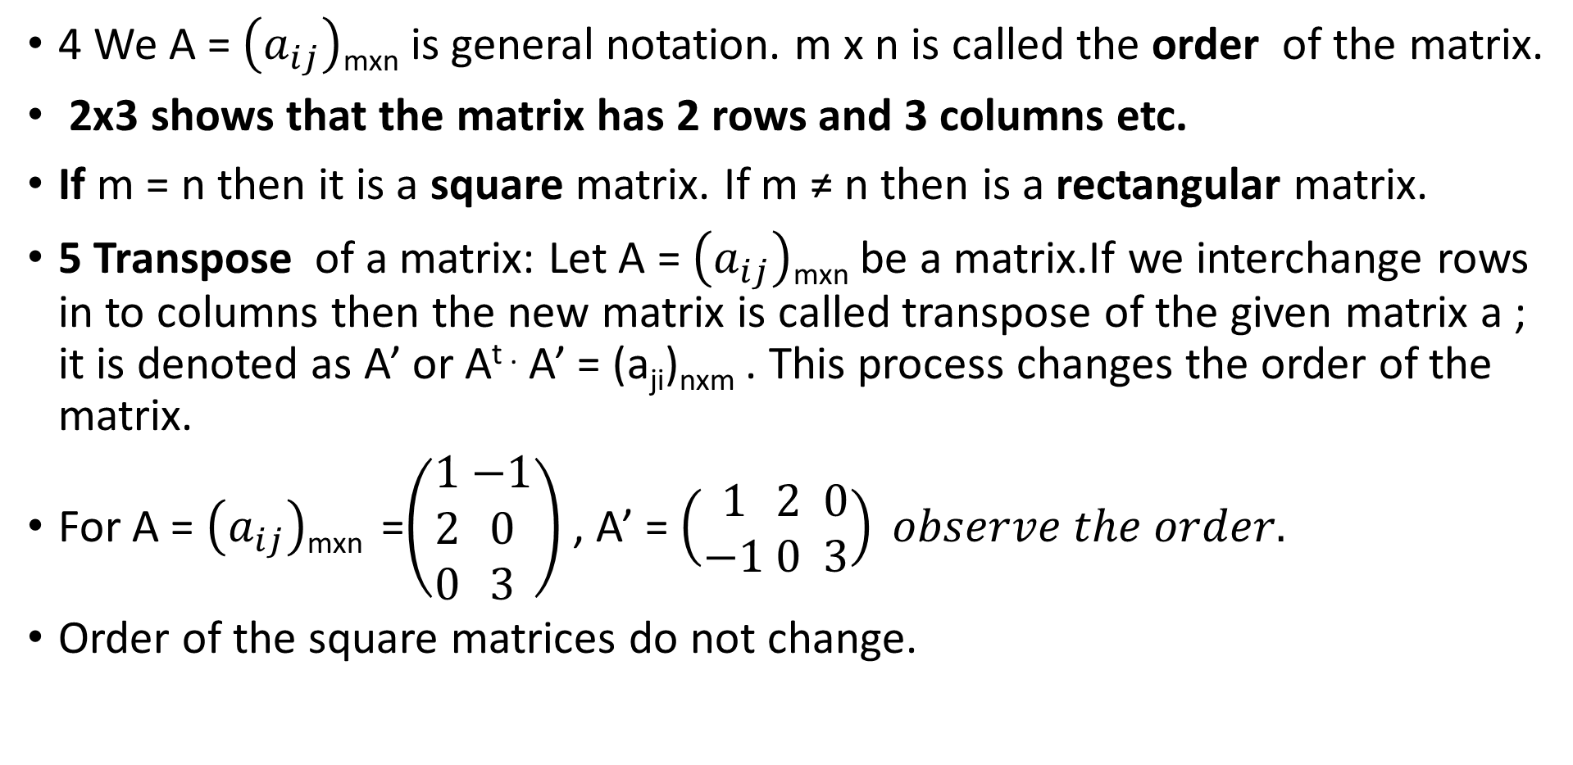
LALP. 3.3
4 We A = $\left(a_{ij}\right)$_{mxn} is general notation. m x n is called the order of the matrix.
2x3 shows that the matrix has 2 rows and 3 columns etc.
If m = n then it is a square matrix. If m ≠ n then is a rectangular matrix.
5 Transpose of a matrix: Let A = $\left(a_{ij}\right)$_{mxn} be a matrix.If we interchange rows in to columns then the new matrix is called transpose of the given matrix a ; it is denoted as A’ or A^{t .} A’ = (a_{ji})_{nxm} . This process changes the order of the matrix.
For A = $\left(a_{ij}\right)$_{mxn} =$\left(\begin{matrix}1 \\ 2 \\ 0\end{matrix} \begin{matrix}−1 \\ 0 \\ 3\end{matrix}\right)$ , A’ = $\left(\begin{matrix}1 \\ −1\end{matrix} \begin{matrix}2 \\ 0\end{matrix} \begin{matrix}0 \\ 3\end{matrix}\right) observe the order.$
Order of the square matrices do not change.

Slide 5
LALP 3.4
Example: Let T: R³ R^{2 ,} T(x, y, z) = (x+y –z, x-y+z) Find the corresponding matrix f linear transformation.
a = (x1,y1,z1) ,T(a) = (x1+y1-z1, x1-y1+z1)
b = (x2,y2,z2) , T(b) =(x2+y2-z2, x2-y2+z2)
To prove L.T. we prove that T(a+b) = T(a) + T(b), and T (ca) = c. T(a)
a + b = ( x1+x2, y1+y2, z1 +z2) , T(a+b) = T(x1+x2, y1+y2, z1 +z2)
= (x1+x2+y1+y2-z1-z2, x1+x2-y1-y2+z1+z2) Is it equa to T(a) + T(b) ?so T(a+b) = T(a) + T(b), check T (ca) is it same as c. T(a)?
T(cx1, cy1, cz1) apply and heck.
Both rules are satisfied and so the transformation is linear., find
T(1,0,0), T(0,1,0) and T (0,0,1)

Slide 6
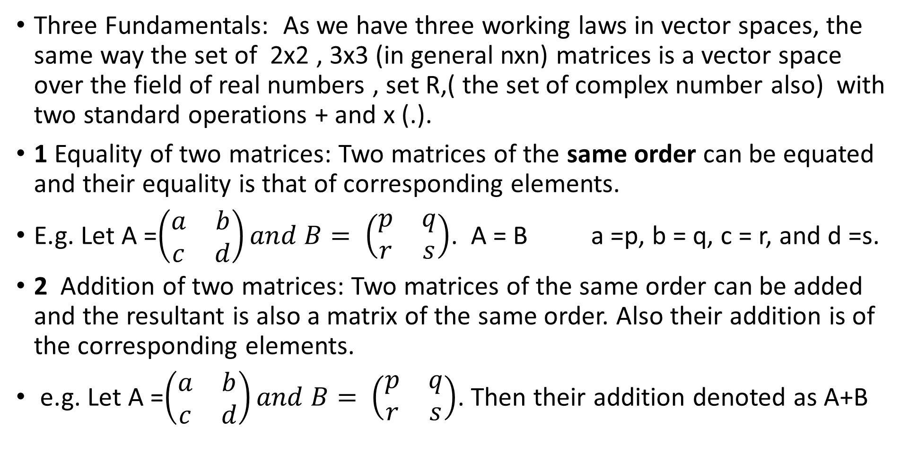
LALP 3.5
Three Fundamentals: As we have three working laws in vector spaces, the same way the set of 2x2 , 3x3 (in general nxn) matrices is a vector space over the field of real numbers , set R,( the set of complex number also) with two standard operations + and x (.).
1 Equality of two matrices: Two matrices of the same order can be equated and their equality is that of corresponding elements.
E.g. Let A =$\left(\begin{matrix}a & b \\ c & d\end{matrix}\right)and B= \left(\begin{matrix}p & q \\ r & s\end{matrix}\right)$. A = B a =p, b = q, c = r, and d =s.
2 Addition of two matrices: Two matrices of the same order can be added and the resultant is also a matrix of the same order. Also their addition is of the corresponding elements.
e.g. Let A =$\left(\begin{matrix}a & b \\ c & d\end{matrix}\right)and B= \left(\begin{matrix}p & q \\ r & s\end{matrix}\right)$. Then their addition denoted as A+B

Slide 7
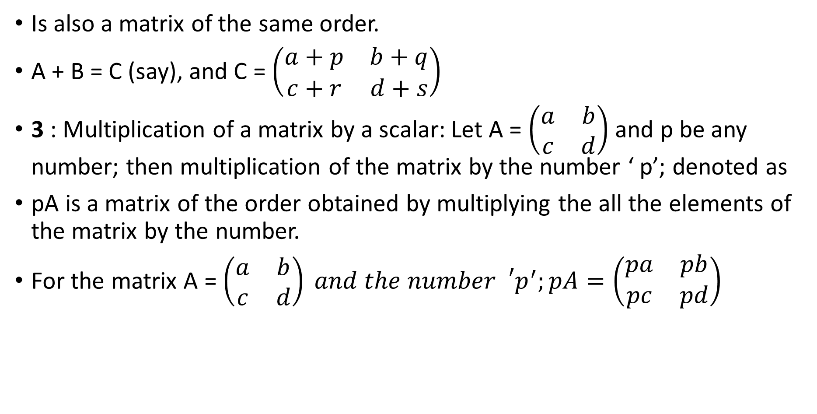
LALP 3.6
Is also a matrix of the same order.
A + B = C (say), and C = $\left(\begin{matrix}a+p & b+q \\ c+r & d+s\end{matrix}\right)$
3 : Multiplication of a matrix by a scalar: Let A = $\left(\begin{matrix}a & b \\ c & d\end{matrix}\right)$ and p be any number; then multiplication of the matrix by the number ‘ p’; denoted as
pA is a matrix of the order obtained by multiplying the all the elements of the matrix by the number.
For the matrix A = $\left(\begin{matrix}a & b \\ c & d\end{matrix}\right) and the number{{}_{}^{′}p}^{′};pA=\left(\begin{matrix}pa & pb \\ pc & pd\end{matrix}\right)$

Slide 8
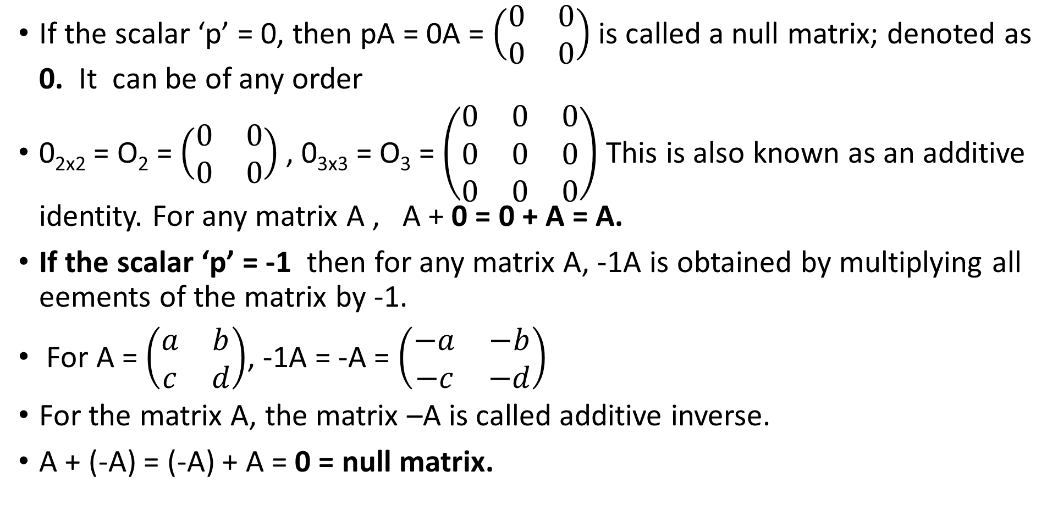
LALP 3.7
If the scalar ‘p’ = 0, then pA = 0A = $\left(\begin{matrix}0 & 0 \\ 0 & 0\end{matrix}\right)$ is called a null matrix; denoted as 0. It can be of any order
0_{2x2} = O₂ = $\left(\begin{matrix}0 & 0 \\ 0 & 0\end{matrix}\right)$ , 0_{3x3} = O₃ = $\left(\begin{matrix}0 & 0 & 0 \\ 0 & 0 & 0 \\ 0 & 0 & 0\end{matrix}\right)$ This is also known as an additive identity. For any matrix A , A + 0 = 0 + A = A.
If the scalar ‘p’ = -1 then for any matrix A, -1A is obtained by multiplying all eements of the matrix by -1.
For A = $\left(\begin{matrix}a & b \\ c & d\end{matrix}\right)$, -1A = -A = $\left(\begin{matrix}−a & −b \\ −c & −d\end{matrix}\right)$
For the matrix A, the matrix –A is called additive inverse.
A + (-A) = (-A) + A = 0 = null matrix.

Slide 9
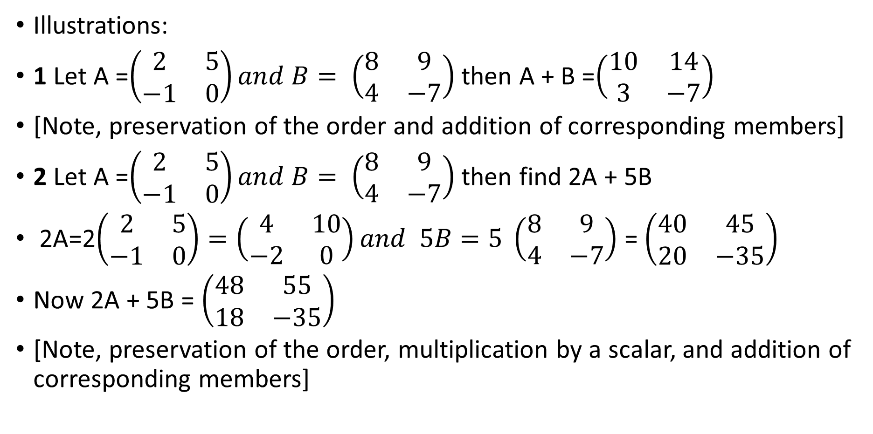
LALP 3.8
Illustrations:
1 Let A =$\left(\begin{matrix}2 & 5 \\ −1 & 0\end{matrix}\right)and B= \left(\begin{matrix}8 & 9 \\ 4 & −7\end{matrix}\right)$ then A + B =$\left(\begin{matrix}10 & 14 \\ 3 & −7\end{matrix}\right)$
[Note, preservation of the order and addition of corresponding members]
2 Let A =$\left(\begin{matrix}2 & 5 \\ −1 & 0\end{matrix}\right)and B= \left(\begin{matrix}8 & 9 \\ 4 & −7\end{matrix}\right)$ then find 2A + 5B
2A=2$\left(\begin{matrix}2 & 5 \\ −1 & 0\end{matrix}\right)=\left(\begin{matrix}4 & 10 \\ −2 & 0\end{matrix}\right)and 5B=5 \left(\begin{matrix}8 & 9 \\ 4 & −7\end{matrix}\right)$ = $\left(\begin{matrix}40 & 45 \\ 20 & −35\end{matrix}\right)$
Now 2A + 5B = $\left(\begin{matrix}48 & 55 \\ 18 & −35\end{matrix}\right)$
[Note, preservation of the order, multiplication by a scalar, and addition of corresponding members]

Slide 10
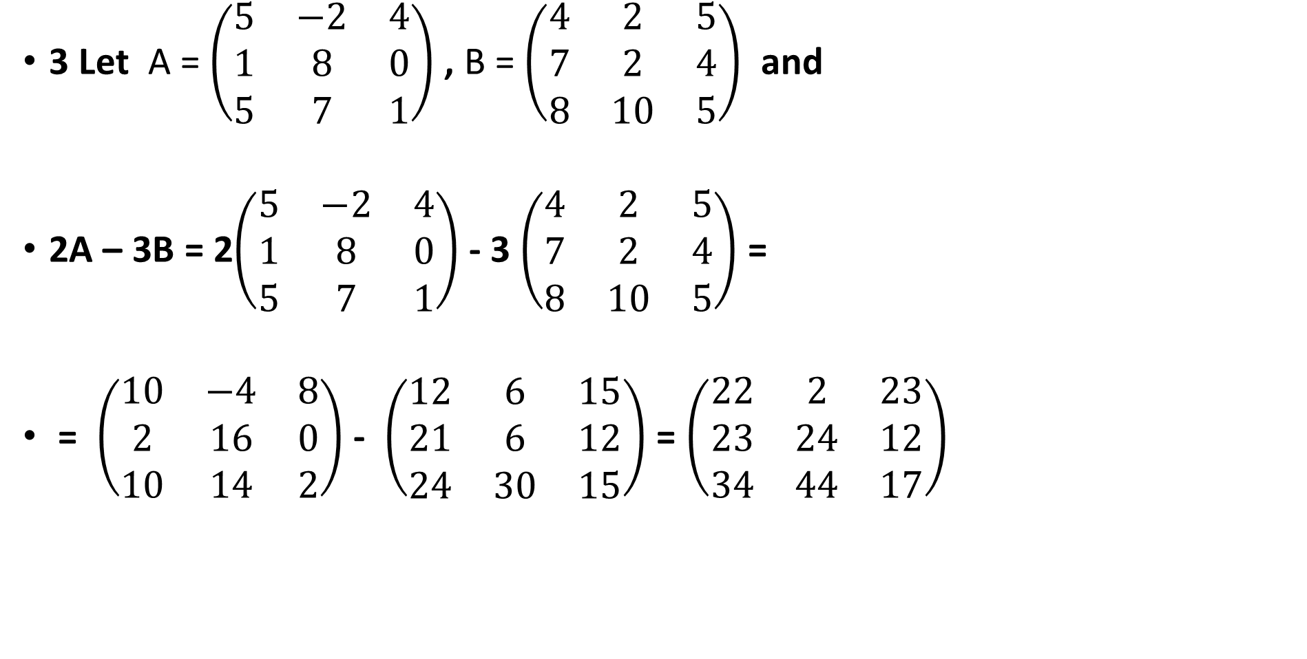
LALP 3.9
3 Let A = $\left(\begin{matrix}5 & −2 & 4 \\ 1 & 8 & 0 \\ 5 & 7 & 1\end{matrix}\right)$ , B = $\left(\begin{matrix}4 & 2 & 5 \\ 7 & 2 & 4 \\ 8 & 10 & 5\end{matrix}\right)$ and
2A – 3B = 2$\left(\begin{matrix}5 & −2 & 4 \\ 1 & 8 & 0 \\ 5 & 7 & 1\end{matrix}\right)$ - 3 $\left(\begin{matrix}4 & 2 & 5 \\ 7 & 2 & 4 \\ 8 & 10 & 5\end{matrix}\right)$ =
= $\left(\begin{matrix}10 & −4 & 8 \\ 2 & 16 & 0 \\ 10 & 14 & 2\end{matrix}\right)$ - $\left(\begin{matrix}12 & 6 & 15 \\ 21 & 6 & 12 \\ 24 & 30 & 15\end{matrix}\right)$ = $\left(\begin{matrix}22 & 2 & 23 \\ 23 & 24 & 12 \\ 34 & 44 & 17\end{matrix}\right)$

Slide 11
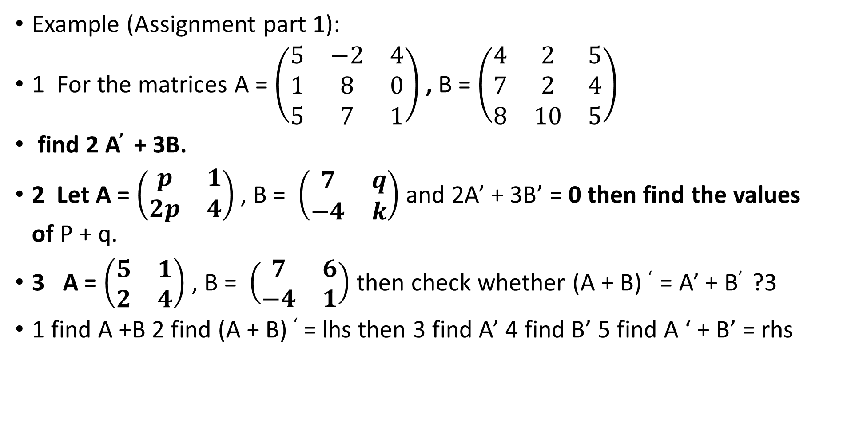
LALP 3.10
Example (Assignment part 1):
1 For the matrices A = $\left(\begin{matrix}5 & −2 & 4 \\ 1 & 8 & 0 \\ 5 & 7 & 1\end{matrix}\right)$ , B = $\left(\begin{matrix}4 & 2 & 5 \\ 7 & 2 & 4 \\ 8 & 10 & 5\end{matrix}\right)$
find 2 A’ + 3B.
2 Let A = $\left(\begin{matrix}p & 1 \\ 2p & 4\end{matrix}\right)$ , B = $\left(\begin{matrix}7 & q \\ −4 & k\end{matrix}\right)$ and 2A’ + 3B’ = 0 then find the values of P + q.
3 A = $\left(\begin{matrix}5 & 1 \\ 2 & 4\end{matrix}\right)$ , B = $\left(\begin{matrix}7 & 6 \\ −4 & 1\end{matrix}\right)$ then check whether (A + B) ‘ = A’ + B’ ?3
1 find A +B 2 find (A + B) ‘ = lhs then 3 find A’ 4 find B’ 5 find A ‘ + B’ = rhs

Slide 12
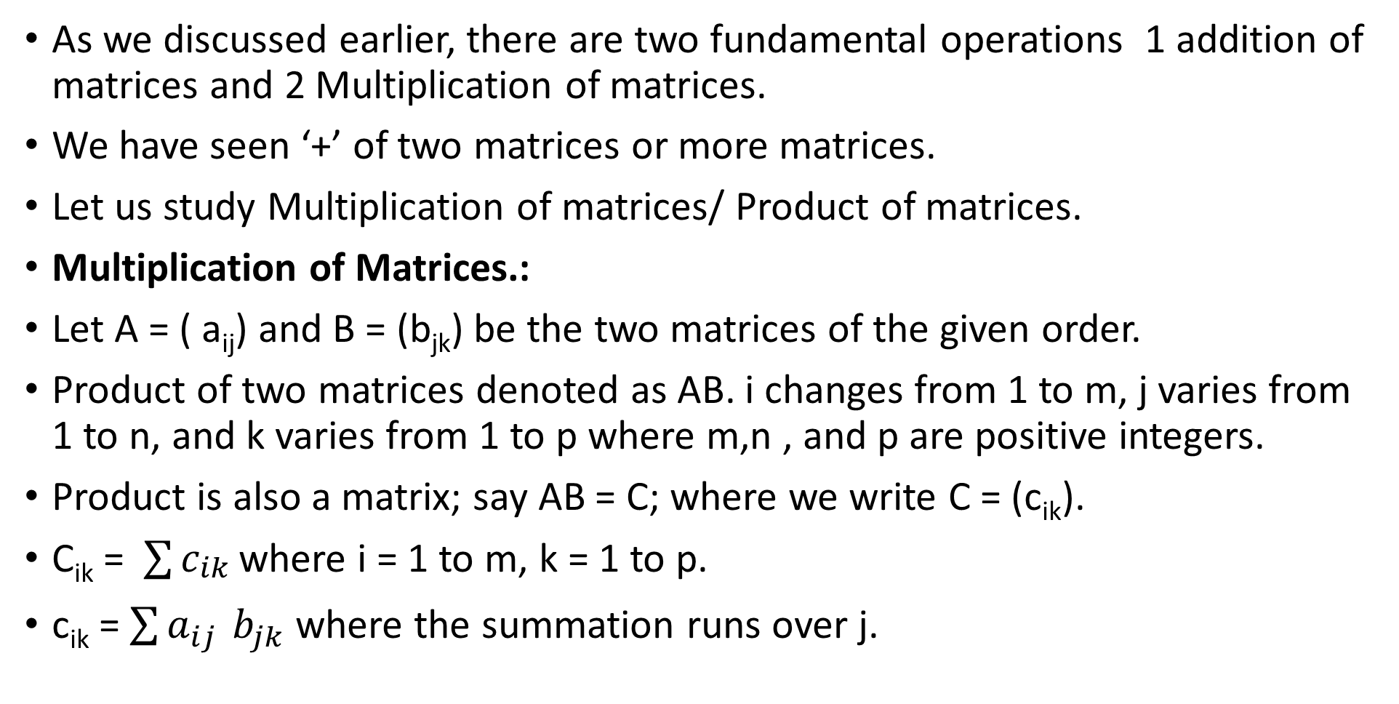
LALP 3.11
As we discussed earlier, there are two fundamental operations 1 addition of matrices and 2 Multiplication of matrices.
We have seen ‘+’ of two matrices or more matrices.
Let us study Multiplication of matrices/ Product of matrices.
Multiplication of Matrices.:
Let A = ( a_{ij}) and B = (b_{jk}) be the two matrices of the given order.
Product of two matrices denoted as AB. i changes from 1 to m, j varies from 1 to n, and k varies from 1 to p where m,n , and p are positive integers.
Product is also a matrix; say AB = C; where we write C = (c_{ik}).
C_{ik} = $\sum{c_{\begin{aligned}ik \\ \end{aligned}}}$where i = 1 to m, k = 1 to p.
c_{ik} = $\sum{a_{ij }}b_{jk}$ where the summation runs over j.

Slide 13
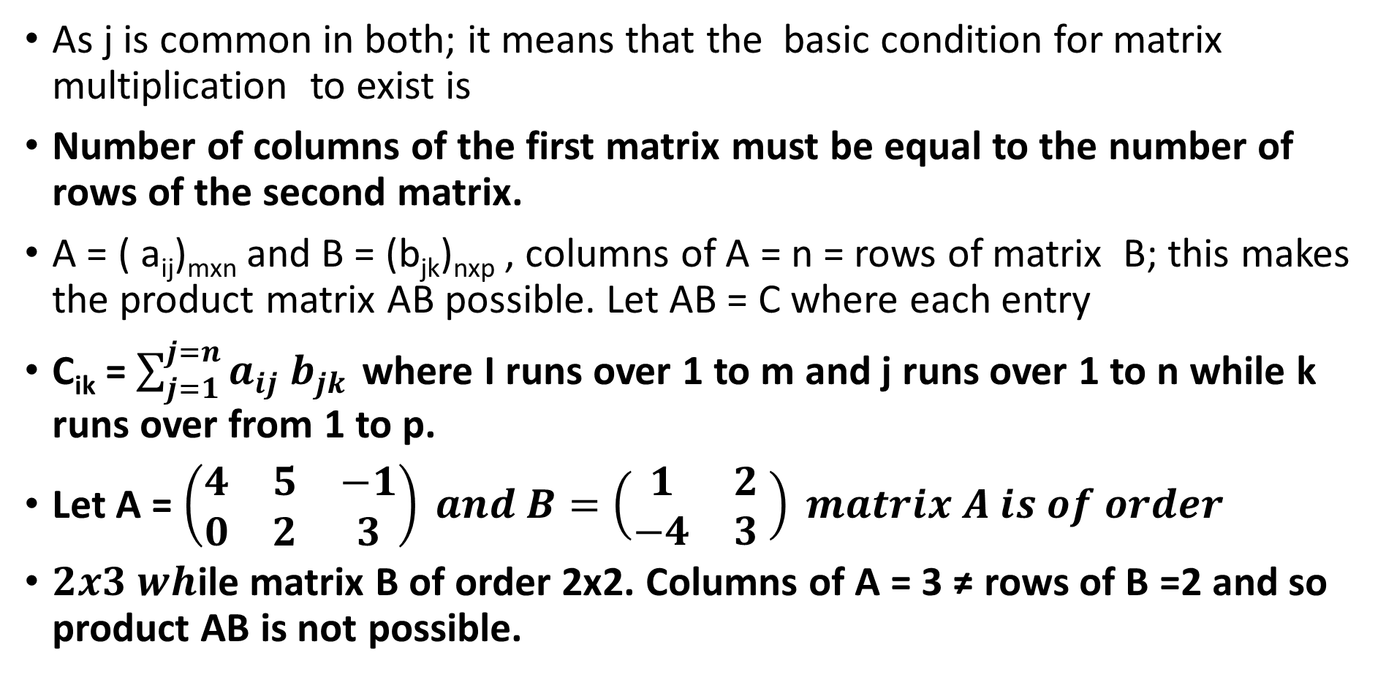
LALP 3.12
As j is common in both; it means that the basic condition for matrix multiplication to exist is
Number of columns of the first matrix must be equal to the number of rows of the second matrix.
A = ( a_{ij})_{mxn} and B = (b_{jk})_{nxp} , columns of A = n = rows of matrix B; this makes the product matrix AB possible. Let AB = C where each entry
C_{ik} = $\sum_{j=1}^{j=n}{a_{ij}}$ $b_{jk }$where I runs over 1 to m and j runs over 1 to n while k runs over from 1 to p.
Let A = $\left(\begin{matrix}4 & 5 & −1 \\ 0 & 2 & 3\end{matrix}\right) and B=\left(\begin{matrix}1 & 2 \\ −4 & 3\end{matrix} \right) matrix A is of order$
$2x3 wh$ile matrix B of order 2x2. Columns of A = 3 ≠ rows of B =2 and so product AB is not possible.

Slide 14
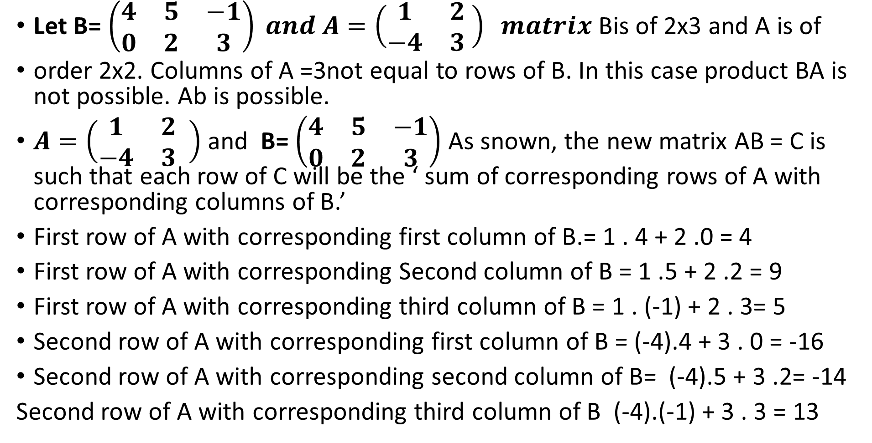
LALP 3.13
Let B= $\left(\begin{matrix}4 & 5 & −1 \\ 0 & 2 & 3\end{matrix}\right) and A=\left(\begin{matrix}1 & 2 \\ −4 & 3\end{matrix} \right) matrix$ Bis of 2x3 and A is of
order 2x2. Columns of A =3not equal to rows of B. In this case product BA is not possible. Ab is possible.
$A=\left(\begin{matrix}1 & 2 \\ −4 & 3\end{matrix} \right)$ and B= $\left(\begin{matrix}4 & 5 & −1 \\ 0 & 2 & 3\end{matrix}\right)$ As snown, the new matrix AB = C is such that each row of C will be the ‘ sum of corresponding rows of A with corresponding columns of B.’
First row of A with corresponding first column of B.= 1 . 4 + 2 .0 = 4
First row of A with corresponding Second column of B = 1 .5 + 2 .2 = 9
First row of A with corresponding third column of B = 1 . (-1) + 2 . 3= 5
Second row of A with corresponding first column of B = (-4).4 + 3 . 0 = -16
Second row of A with corresponding second column of B= (-4).5 + 3 .2= -14
Second row of A with corresponding third column of B (-4).(-1) + 3 . 3 = 13

Slide 15
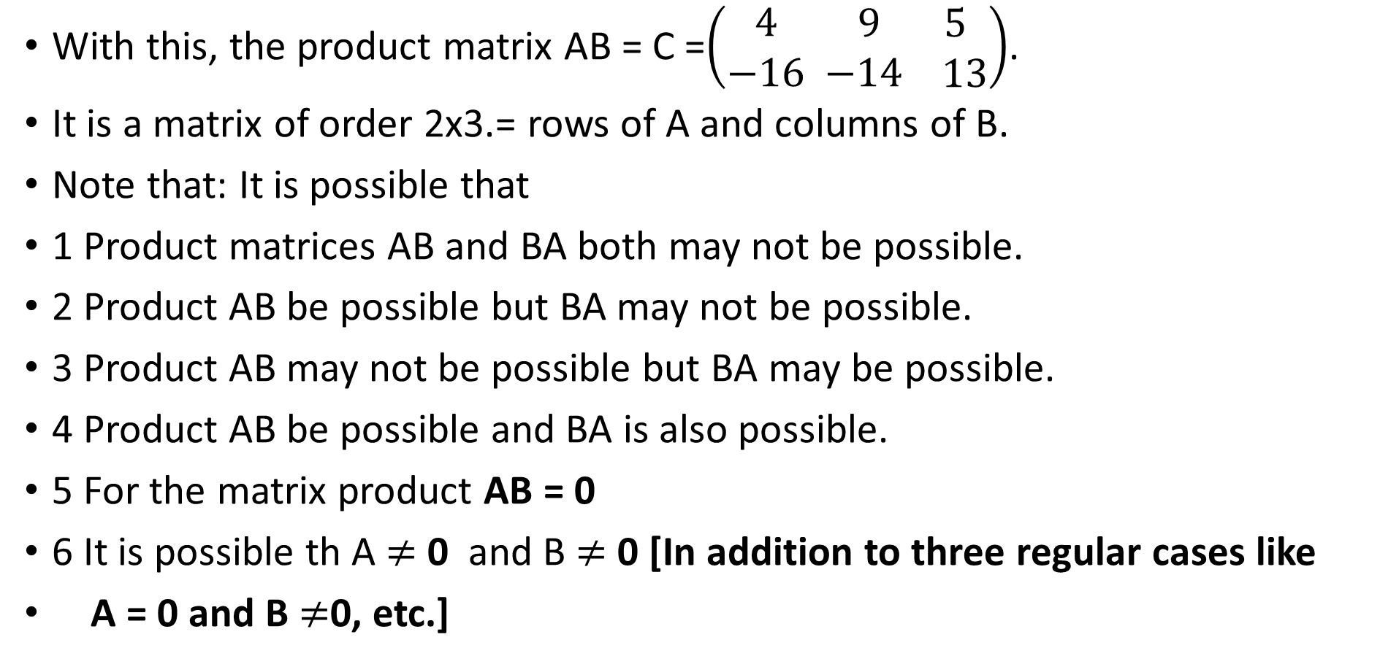
LALP 3.14
With this, the product matrix AB = C =$\left(\begin{matrix}4 \\ −16\end{matrix}\begin{matrix} 9 \\ −14\end{matrix}\begin{matrix} 5 \\ 13\end{matrix}\right)$.
It is a matrix of order 2x3.= rows of A and columns of B.
Note that: It is possible that
1 Product matrices AB and BA both may not be possible.
2 Product AB be possible but BA may not be possible.
3 Product AB may not be possible but BA may be possible.
4 Product AB be possible and BA is also possible.
5 For the matrix product AB = 0
6 It is possible th A $≠$ 0 and B $≠$ 0 [In addition to three regular cases like
A = 0 and B $≠$0, etc.]

Slide 16
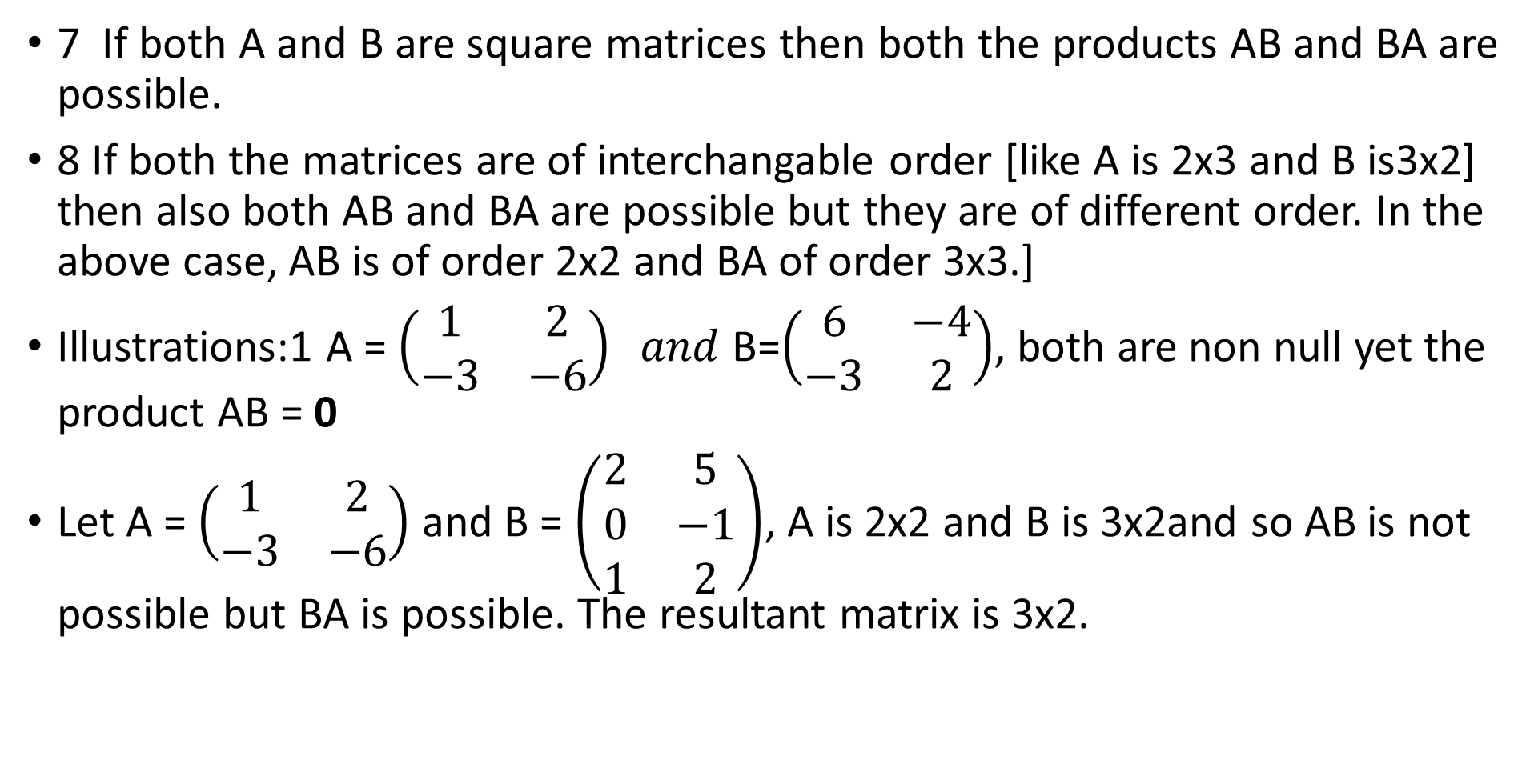
LALP 3.15
7 If both A and B are square matrices then both the products AB and BA are possible.
8 If both the matrices are of interchangable order [like A is 2x3 and B is3x2] then also both AB and BA are possible but they are of different order. In the above case, AB is of order 2x2 and BA of order 3x3.]
Illustrations:1 A = $\left(\begin{matrix}1 & 2 \\ −3 & −6\end{matrix}\right) and$ B=$\left(\begin{matrix}6 & −4 \\ −3 & 2\end{matrix}\right)$, both are non null yet the product AB = 0
Let A = $\left(\begin{matrix}1 & 2 \\ −3 & −6\end{matrix}\right)$ and B = $\left(\begin{matrix}2 & 5 \\ 0 & −1 \\ 1 & 2\end{matrix}\right)$, A is 2x2 and B is 3x2and so AB is not possible but BA is possible. The resultant matrix is 3x2.

Slide 17
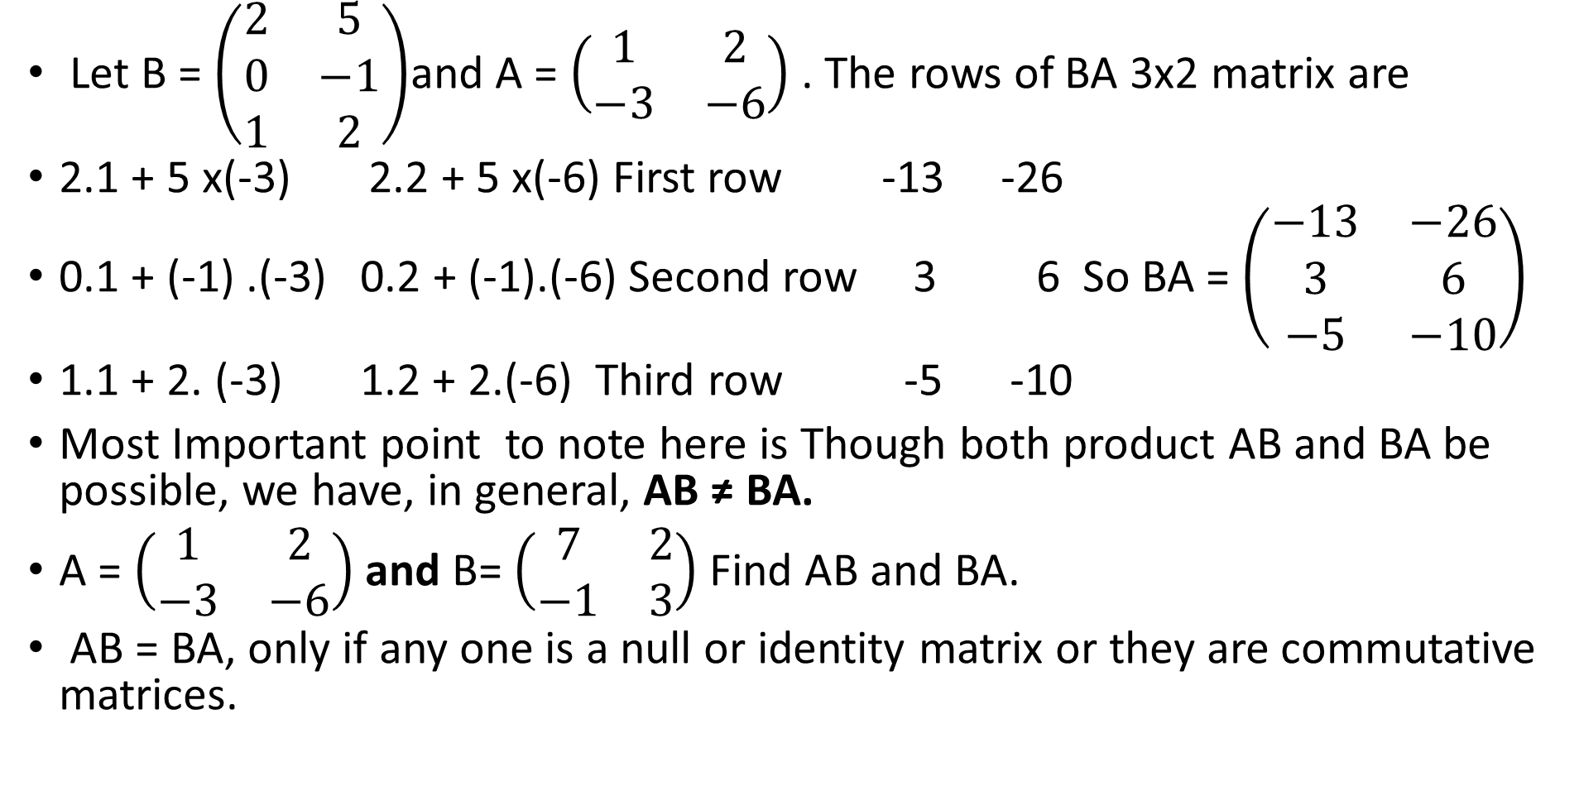
LALP 3.16
Let B = $\left(\begin{matrix}2 & 5 \\ 0 & −1 \\ 1 & 2\end{matrix}\right)$and A = $\left(\begin{matrix}1 & 2 \\ −3 & −6\end{matrix}\right)$ . The rows of BA 3x2 matrix are
2.1 + 5 x(-3) 2.2 + 5 x(-6) First row -13 -26
0.1 + (-1) .(-3) 0.2 + (-1).(-6) Second row 3 6 So BA = $\left(\begin{matrix}−13 & −26 \\ 3 & 6 \\ −5 & −10\end{matrix}\right)$
1.1 + 2. (-3) 1.2 + 2.(-6) Third row -5 -10
Most Important point to note here is Though both product AB and BA be possible, we have, in general, AB ≠ BA.
A = $\left(\begin{matrix}1 & 2 \\ −3 & −6\end{matrix}\right)$ and B= $\left(\begin{matrix}7 & 2 \\ −1 & 3\end{matrix}\right)$ Find AB and BA.
AB = BA, only if any one is a null or identity matrix or they are commutative matrices.

Slide 18
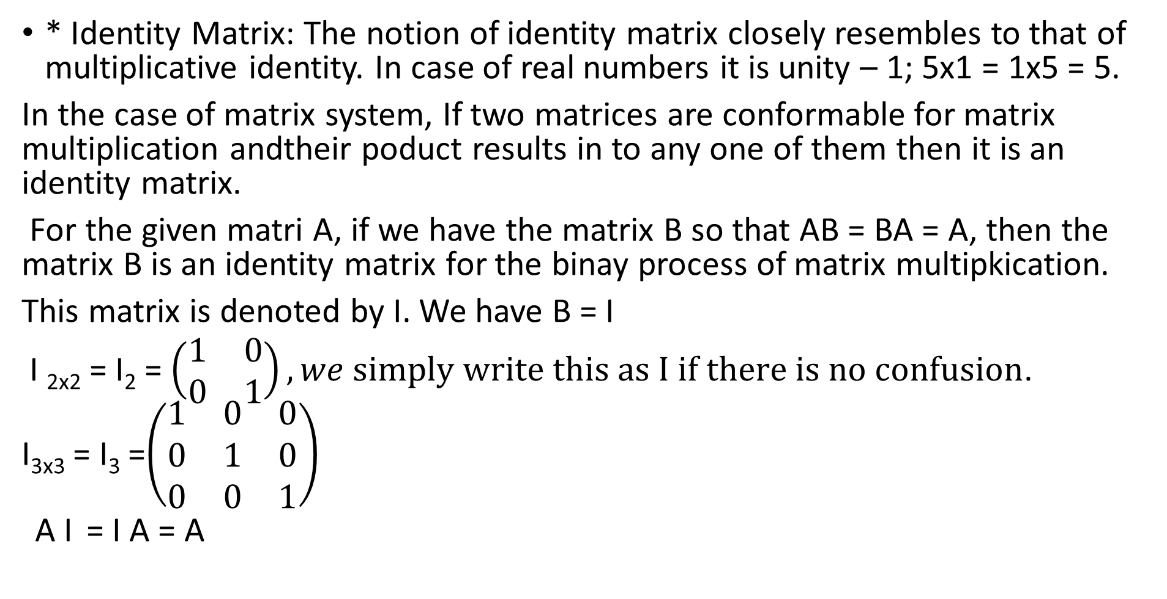
LALP 3.17
* Identity Matrix: The notion of identity matrix closely resembles to that of multiplicative identity. In case of real numbers it is unity – 1; 5x1 = 1x5 = 5.
In the case of matrix system, If two matrices are conformable for matrix multiplication andtheir poduct results in to any one of them then it is an identity matrix.
For the given matri A, if we have the matrix B so that AB = BA = A, then the matrix B is an identity matrix for the binay process of matrix multipkication.
This matrix is denoted by I. We have B = I
I _{2x2} = I₂ = $\left(\begin{matrix}1 & 0 \\ 0 & 1\end{matrix}\right), we simply write this as I if there is no confusion$.
I_{3x3} = I₃ =$\left(\begin{matrix}1 & 0 & 0 \\ 0 & 1 & 0 \\ 0 & 0 & 1\end{matrix}\right)$
A I = I A = A

Slide 19
LALP 3.18
Determinant of a square matrix: We know that a matrix is an arrangement or it is a presentation of common values of two different variables.
students
a b
Marks Now, one can meaningfully read each entry. There can be
different values to rows and columns.
Test 1 5 9
Test 2 6 4 If write these entries in the form of a determinant then
We have the notion of determinant. A determinant stands for a real value in the case of different order. [ Only square form]
It shows a real value and it has meaningful different value.

Slide 20
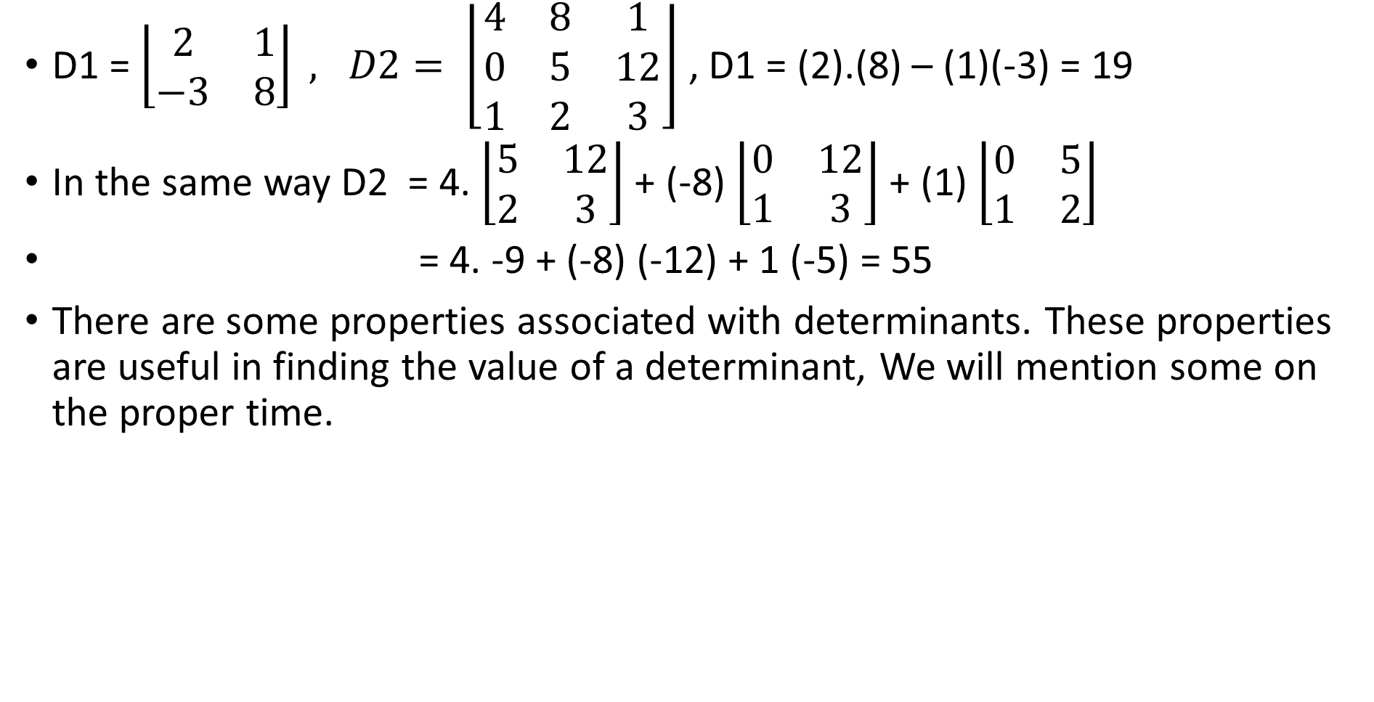
LALP 3.19
D1 = $\left\lfloor \begin{matrix}2 & 1 \\ −3 & 8\end{matrix}\right\rfloor , D2= \left\lfloor \begin{matrix}4 & 8 & 1 \\ 0 & 5 & 12 \\ 1 & 2 & 3\end{matrix}\right\rfloor$ , D1 = (2).(8) – (1)(-3) = 19
In the same way D2 = 4. $\left\lfloor \begin{matrix}5 & 12 \\ 2 & 3\end{matrix}\right\rfloor$+ (-8) $\left\lfloor \begin{matrix}0 & 12 \\ 1 & 3\end{matrix}\right\rfloor$+ (1) $\left\lfloor \begin{matrix}0 & 5 \\ 1 & 2\end{matrix}\right\rfloor$
= 4. -9 + (-8) (-12) + 1 (-5) = 55
There are some properties associated with determinants. These properties are useful in finding the value of a determinant, We will mention some on the proper time.

Slide 21
LALP 3.20
Inverse of a given matrix: As set of all square matrices on the given field of real numbers generate a vectors space with two binary operations + and ‘ . ‘, we must have a multiplicative inverse to each non-singular matrix.
For a given matrix A if we another matrix B so thar the product
AB =BA = I = identity matrix, then the matrix B is called the inverse of the given matrix A; it denoted = A⁻¹
In fact A and B are inverses of each other. A = B⁻¹ and B = A⁻¹
i.e A A⁻¹ = A⁻¹ A = I identity matix.
We have given conditions ; A must be a square matrix and it must be non-singular. A given non-singular matrix can possess inverse.

Slide 22
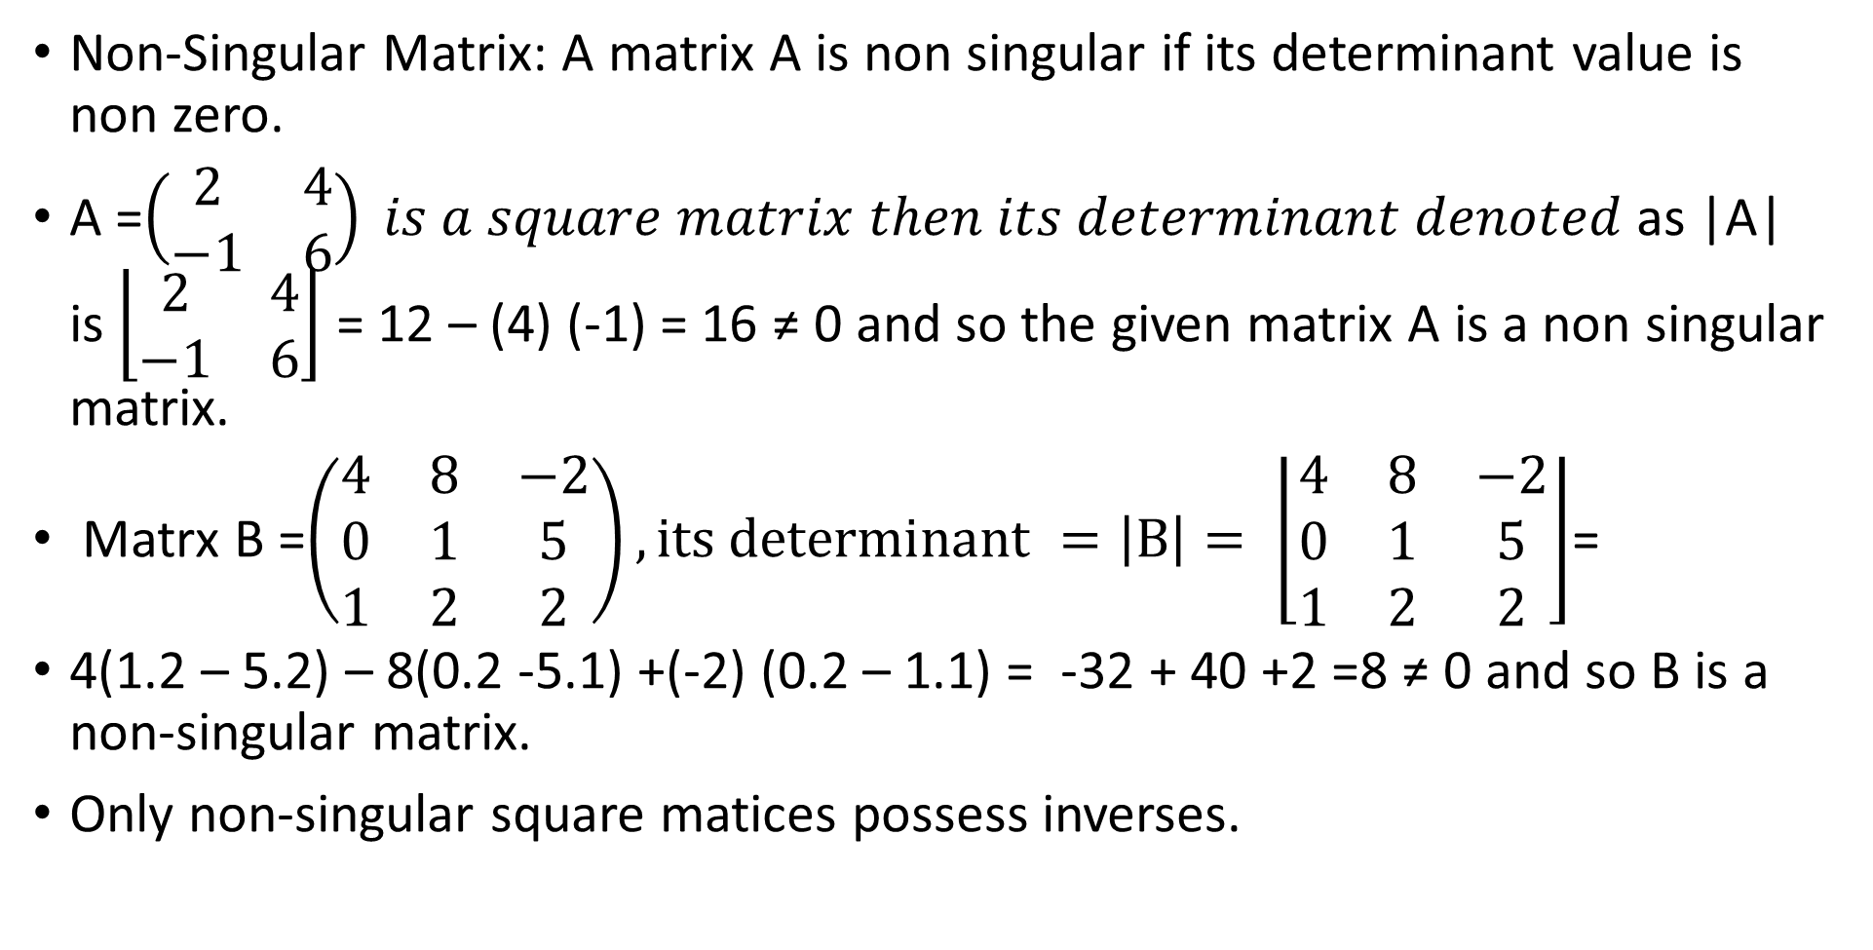
LALP 3.21
Non-Singular Matrix: A matrix A is non singular if its determinant value is non zero.
A =$\left(\begin{matrix}2 & 4 \\ −1 & 6\end{matrix}\right) is a square matrix then its determinant denoted$as |A| is $\left\lfloor \begin{matrix}2 & 4 \\ −1 & 6\end{matrix}\right\rfloor$ = 12 – (4) (-1) = 16 ≠ 0 and so the given matrix A is a non singular matrix.
Matrx B =$\left(\begin{matrix}4 & 8 & −2 \\ 0 & 1 & 5 \\ 1 & 2 & 2\end{matrix}\right), its determinant =\left|B\right|= \left\lfloor \begin{matrix}4 & 8 & −2 \\ 0 & 1 & 5 \\ 1 & 2 & 2\end{matrix}\right\rfloor$=
4(1.2 – 5.2) – 8(0.2 -5.1) +(-2) (0.2 – 1.1) = -32 + 40 +2 =8 ≠ 0 and so B is a non-singular matrix.
Only non-singular square matices possess inverses.

Slide 23
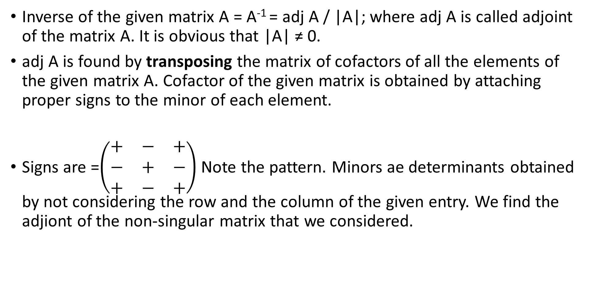
LALP 3.22
Inverse of the given matrix A = A⁻¹ = adj A / |A|; where adj A is called adjoint of the matrix A. It is obvious that |A| ≠ 0.
adj A is found by transposing the matrix of cofactors of all the elements of the given matrix A. Cofactor of the given matrix is obtained by attaching proper signs to the minor of each element.
Signs are =$\left(\begin{matrix}+ & − & + \\ − & + & − \\ + & − & +\end{matrix}\right)$ Note the pattern. Minors ae determinants obtained by not considering the row and the column of the given entry. We find the adjiont of the non-singular matrix that we considered.

Slide 24
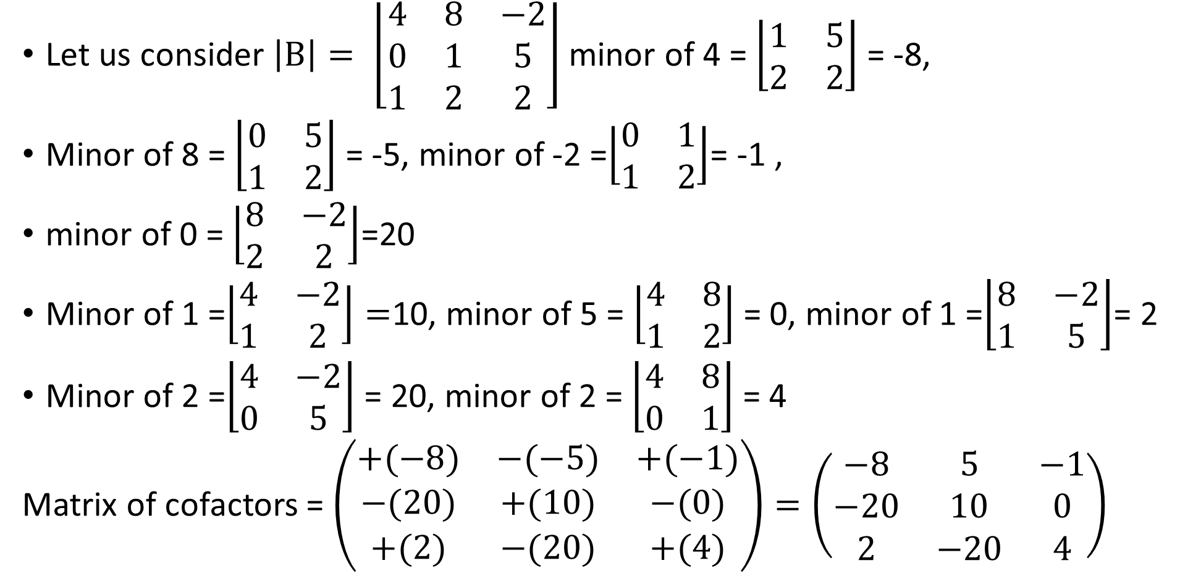
LALP 3.23
Let us consider $\left|B\right|= \left\lfloor \begin{matrix}4 & 8 & −2 \\ 0 & 1 & 5 \\ 1 & 2 & 2\end{matrix}\right\rfloor$ minor of 4 = $\left\lfloor \begin{matrix}1 & 5 \\ 2 & 2\end{matrix}\right\rfloor$ = -8,
Minor of 8 = $\left\lfloor \begin{matrix}0 & 5 \\ 1 & 2\end{matrix}\right\rfloor$ = -5, minor of -2 =$\left\lfloor \begin{matrix}0 & 1 \\ 1 & 2\end{matrix}\right\rfloor$= -1 ,
minor of 0 = $\left\lfloor \begin{matrix}8 & −2 \\ 2 & 2\end{matrix}\right\rfloor$=20
Minor of 1 =$\left\lfloor \begin{matrix}4 & −2 \\ 1 & 2\end{matrix}\right\rfloor =$10, minor of 5 = $\left\lfloor \begin{matrix}4 & 8 \\ 1 & 2\end{matrix}\right\rfloor$ = 0, minor of 1 =$\left\lfloor \begin{matrix}8 & −2 \\ 1 & 5\end{matrix}\right\rfloor$= 2
Minor of 2 =$\left\lfloor \begin{matrix}4 & −2 \\ 0 & 5\end{matrix}\right\rfloor$ = 20, minor of 2 = $\left\lfloor \begin{matrix}4 & 8 \\ 0 & 1\end{matrix}\right\rfloor$ = 4
Matrix of cofactors = $\left(\begin{matrix}+(−8) & −(−5) & +(−1) \\ −(20) & +(10) & −(0) \\ +(2) & −(20) & +(4)\end{matrix}\right)=\left(\begin{matrix}−8 & 5 & −1 \\ −20 & 10 & 0 \\ 2 & −20 & 4\end{matrix}\right)$

Slide 25
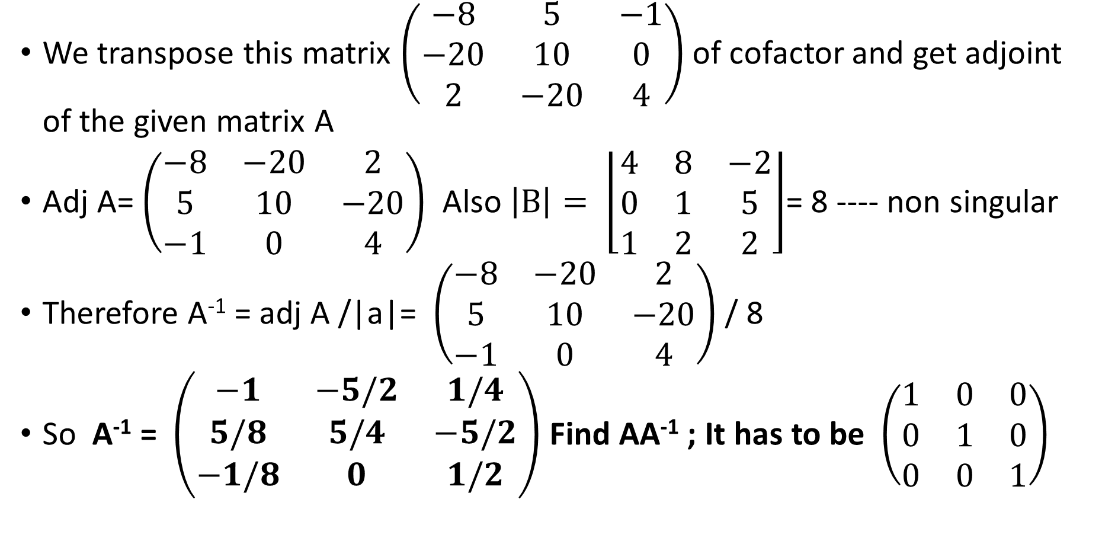
LALP 3.24
We transpose this matrix $\left(\begin{matrix}−8 & 5 & −1 \\ −20 & 10 & 0 \\ 2 & −20 & 4\end{matrix}\right)$ of cofactor and get adjoint of the given matrix A
Adj A= $\left(\begin{matrix}−8 & −20 & 2 \\ 5 & 10 & −20 \\ −1 & 0 & 4\end{matrix}\right)$ Also $\left|B\right|= \left\lfloor \begin{matrix}4 & 8 & −2 \\ 0 & 1 & 5 \\ 1 & 2 & 2\end{matrix}\right\rfloor$= 8 ---- non singular
Therefore A⁻¹ = adj A /|a|= $\left(\begin{matrix}−8 & −20 & 2 \\ 5 & 10 & −20 \\ −1 & 0 & 4\end{matrix}\right)$ / 8
So A⁻¹ = $\left(\begin{matrix}−1 & −5/2 & 1/4 \\ 5/8 & 5/4 & −5/2 \\ −1/8 & 0 & 1/2\end{matrix}\right)$ Find AA⁻¹ ; It has to be $\left(\begin{matrix}1 & 0 & 0 \\ 0 & 1 & 0 \\ 0 & 0 & 1\end{matrix}\right)$

Slide 26
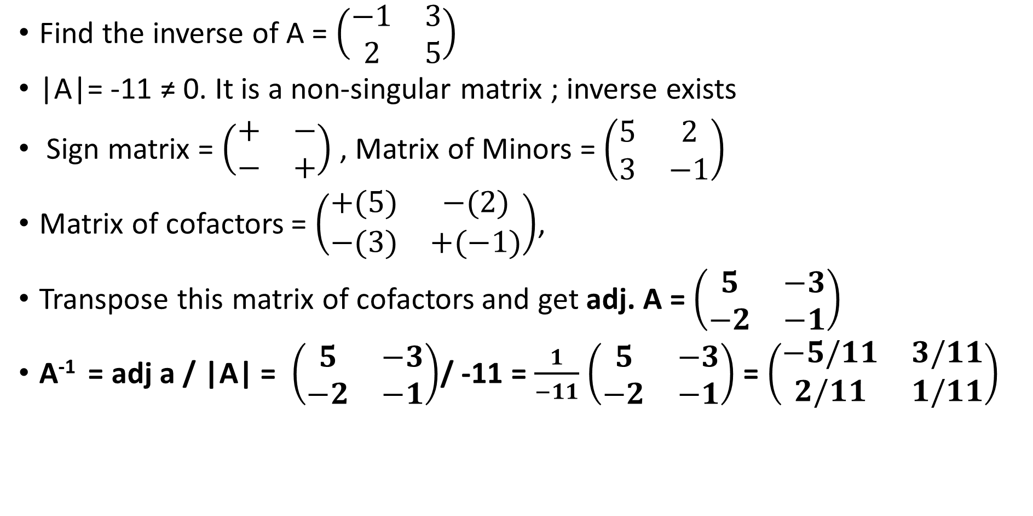
LALP 3.25
Find the inverse of A = $\left(\begin{matrix}−1 & 3 \\ 2 & 5\end{matrix}\right)$
|A|= -11 ≠ 0. It is a non-singular matrix ; inverse exists
Sign matrix = $\left(\begin{matrix}+ & − \\ − & +\end{matrix}\right)$ , Matrix of Minors = $\left(\begin{matrix}5 & 2 \\ 3 & −1\end{matrix}\right)$
Matrix of cofactors = $\left(\begin{matrix}+(5) & −(2) \\ −(3) & +(−1)\end{matrix}\right)$,
Transpose this matrix of cofactors and get adj. A = $\left(\begin{matrix}5 & −3 \\ −2 & −1\end{matrix}\right)$
A⁻¹ = adj a / |A| = $\left(\begin{matrix}5 & −3 \\ −2 & −1\end{matrix}\right)$/ -11 = $\frac{1}{−11}$ $\left(\begin{matrix}5 & −3 \\ −2 & −1\end{matrix}\right)$ = $\left(\begin{matrix}−5/11 & 3/11 \\ 2/11 & 1/11\end{matrix}\right)$

Slide 27
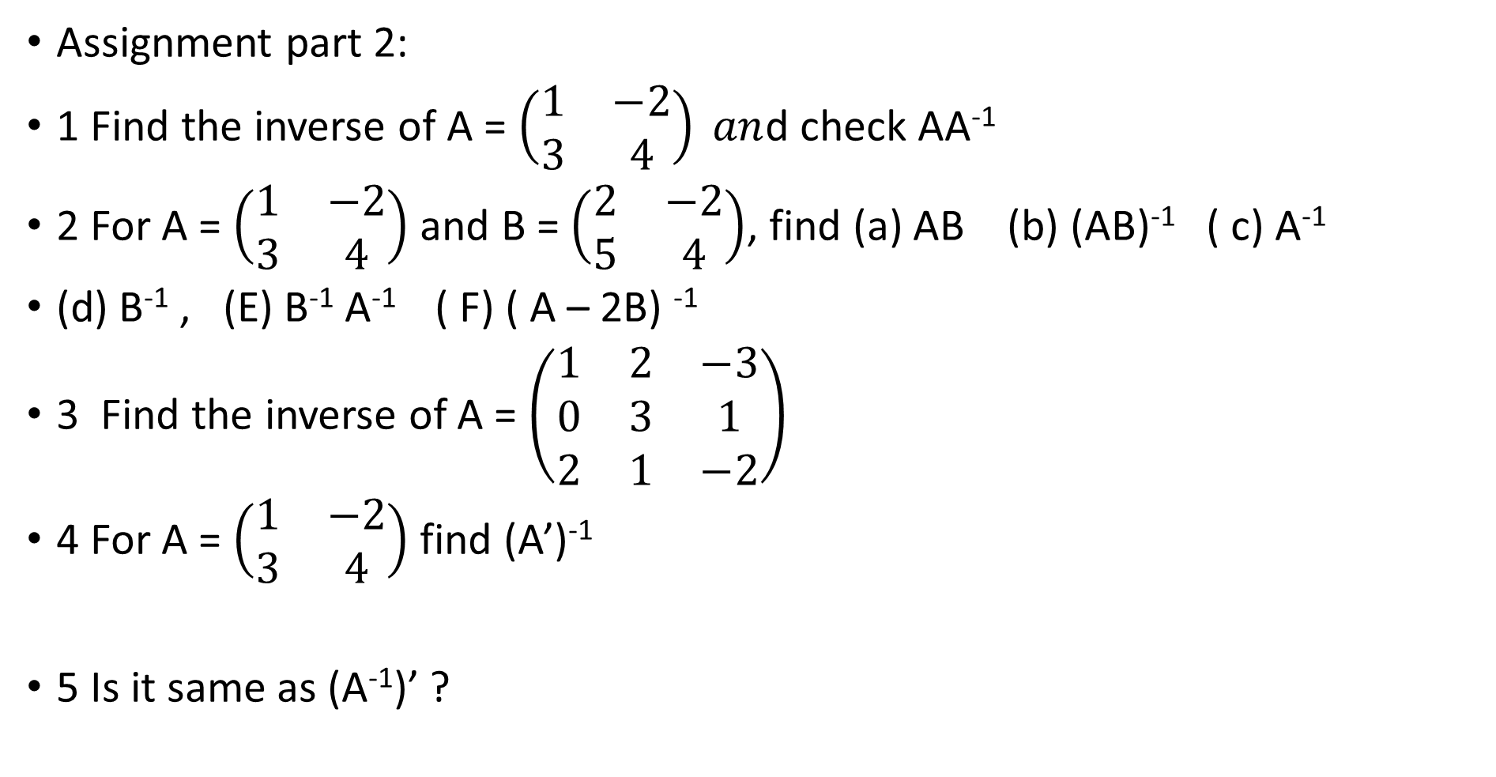
LALP 3.26
Assignment part 2:
1 Find the inverse of A = $\left(\begin{matrix}1 & −2 \\ 3 & 4\end{matrix}\right) an$d check AA⁻¹
2 For A = $\left(\begin{matrix}1 & −2 \\ 3 & 4\end{matrix}\right)$ and B = $\left(\begin{matrix}2 & −2 \\ 5 & 4\end{matrix}\right)$, find (a) AB (b) (AB)⁻¹ ( c) A⁻¹
(d) B⁻¹ , (E) B⁻¹ A⁻¹ ( F) ( A – 2B) ⁻¹
3 Find the inverse of A = $\left(\begin{matrix}1 & 2 & −3 \\ 0 & 3 & 1 \\ 2 & 1 & −2\end{matrix}\right)$
4 For A = $\left(\begin{matrix}1 & −2 \\ 3 & 4\end{matrix}\right)$ find (A’)⁻¹
5 Is it same as (A⁻¹)’ ?

